Slide 1
Communication
Writing
Koen Van Eyken
Charlotte Binnemans

Slide 2
Agenda
When
Punctuation
Capitals
Spelling
Grammar
Consistency
Lay-out
Emails
Sources
What to remember?
Notes:
https://www.youtube.com/watch?v=90Xx7PAiqY8
2

Slide 3
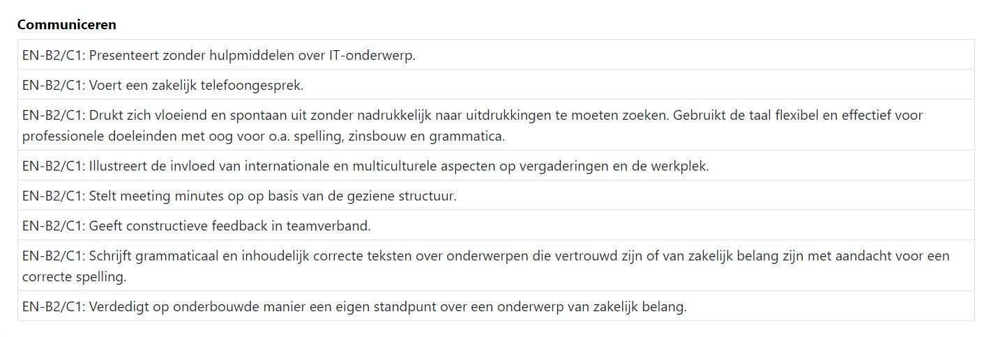
Learning objectives

Slide 4
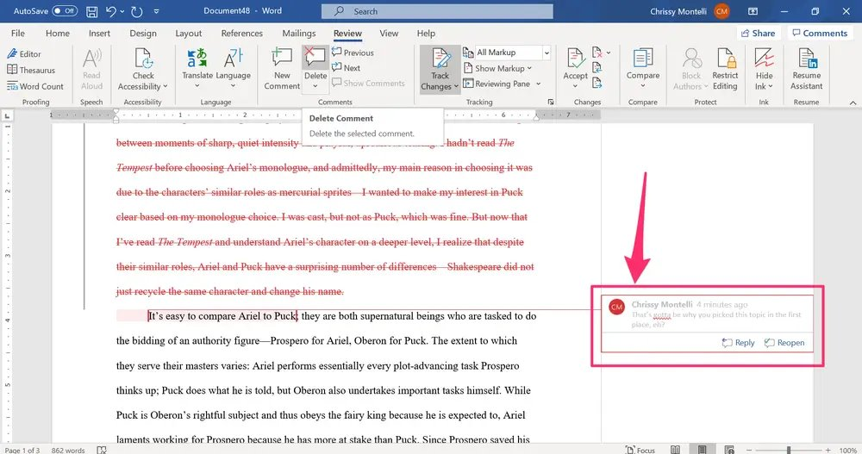
When
When the developer helped the client, she sneezed.
Final Project
Functional Analysis document
Technical Analysis document
Test documents
E-mail
Instruction manual
We added an extra API to the program and then removed it.
The First Ikon Make Sir That there is still spaace voor extr funtcionality in The next fase.
Notes:
https://www.youtube.com/watch?v=90Xx7PAiqY8
4

Slide 5
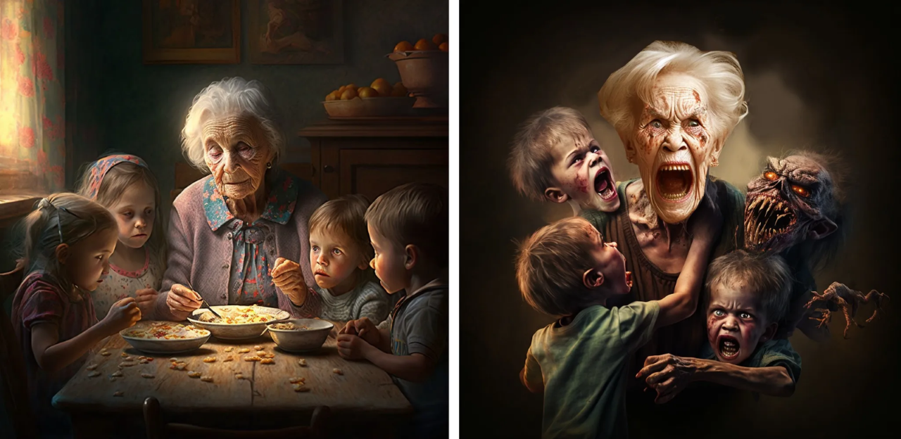
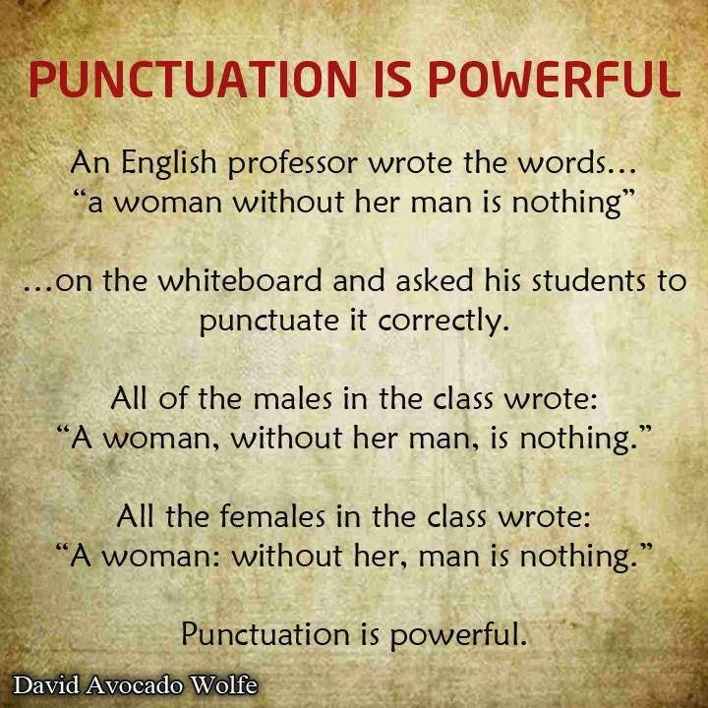
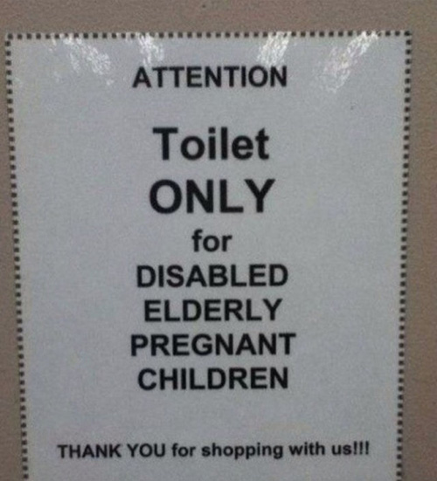
Punctuation
Let’s eat, grandma!
Let’s eat grandma!
Notes:
https://www.youtube.com/watch?v=90Xx7PAiqY8
5

Slide 6
Punctuation - Comma
The designer, who entered the room, gave me the drawing.
The designer who entered the room gave me the drawing.
How many designers are there?
The Poca group, which helped me, has over 200 employees.
The Poca group which helped me has over 200 employees.
I’m confused.
Notes:
6

Slide 7
Punctuation - Comma
Use a comma in a non-defining clause!
Extra information, can be omitted?
→ Comma!
Makes sure we’re talking about THAT subject?
→ No comma
Notes:
7

Slide 8
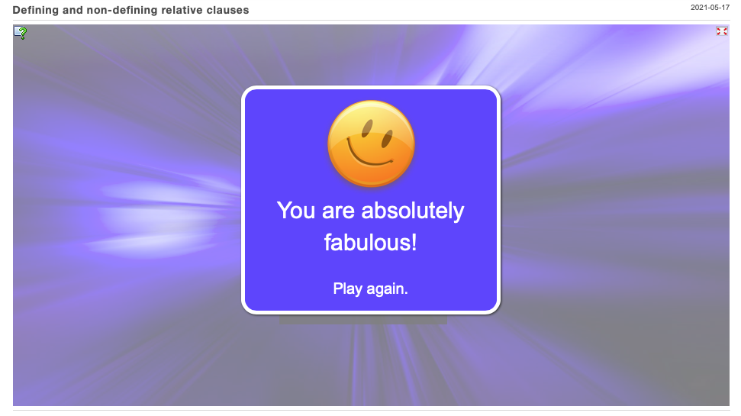
Exercise
Who wants to be a millionaire?
Notes:
8

Slide 9
Punctuation - Lists
Complete sentence?
The IT Manager made three comments about using the computers:
Turn them off when you are done with them.
Staff must be trained to use new IT equipment.
Don't think that technology will cure all our problems.
Words or parts of a sentence
Any good IT office should have the following:
A coffee machine
Wi-Fi
Plenty of windows
Notes:
https://www.youtube.com/watch?v=90Xx7PAiqY8
9

Slide 10

Capitals
Names - Belgium, Agile Foundation, Van Eyken
Beginning of a sentence - The network is completely secure.
Titles - The Agile Manifesto
Abbreviations - API, KPI
Languages – English, Russian
Days, Months, ...
Use a capital!
Notes:
https://www.youtube.com/watch?v=90Xx7PAiqY8
10

Slide 11

Capitals
NO CAPITALS
Verbs and adverbs - e-mailing, agile
After colon - There are two reasons: it’s fast and it’s easy to write.
Classes - geography, math(s), BUT French
Misc. - winter, sun, man, dog
Unless ...
Do not use a capital.
Notes:
https://www.youtube.com/watch?v=90Xx7PAiqY8
11

Slide 12
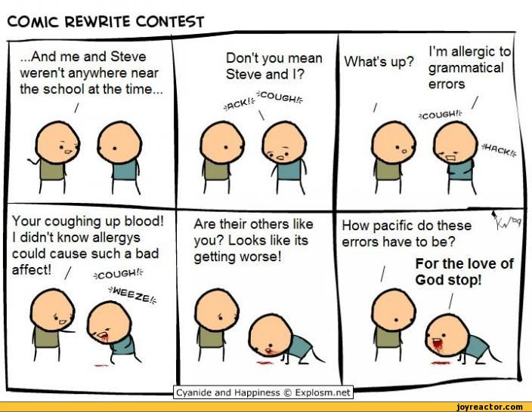
Kahoot
https://cyanideandhappiness.fandom.com/wiki/Comic_Rewrite_Contest

Slide 13
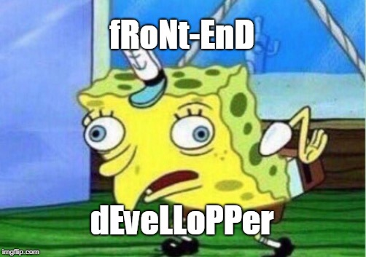
Consistency
User Manuals are found in the User manual segment of the user-manual library.
Back-end and Frontend developers join the back end team
I use an API in my api-management tool.
The developer joins the devellopment team.
I think that i am using the correct email address for sending him this e-mail about E-mailing Presidents.
The authorisation rules are that only authorized people are allowed to enter data.
There are three reasons.
He is happy.
he is tall
He’s crazy.
Notes:
http://www.forbes.com/sites/work-in-progress/2013/12/05/six-surprising-negotiation-tactics-that-get-you-the-best-deal/
13

Slide 14
Lay-out
Use a template.
Not too many colours.
Lay-out of sentences
Reread, edit, reread again, let someone else read it.
Notes:
14

Slide 15
Lay-out
Log in
Image 1. Example of a use case
Captions
Meaningful
Consistent placement
Page numbers
Use them
Not on cover page
Check them again
Notes:
15

Slide 16
Lay-out
Titles
USE THEM
Same title on cover and table of contents page
Title not IN table of contents
Version control
Consistent numbering
Versions
Final version is 1.0
Distribution to people
Notes:
16

Slide 17
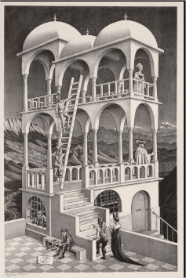
Lay-out
Beeld: Kleine tekening
Tekening
Notes:
17

Slide 18

Emails
Dear Sir van Eyken
Dear Professor Binnemans
Dear mr. Koen
[nothing]
Dear Mr. Binnemans
Dear van Ryken
Hey, hi, hello, helleuw
dear Mrs. Binnemans
Dear Binnenmans
→ Dear Mrs. Binnemans
→ Dear Mr. Van Eyken
A knighted lecturer.
Source: Image generated by Bing Image Creator
Notes:
http://dictionary.cambridge.org/dictionary/english/email

Slide 19
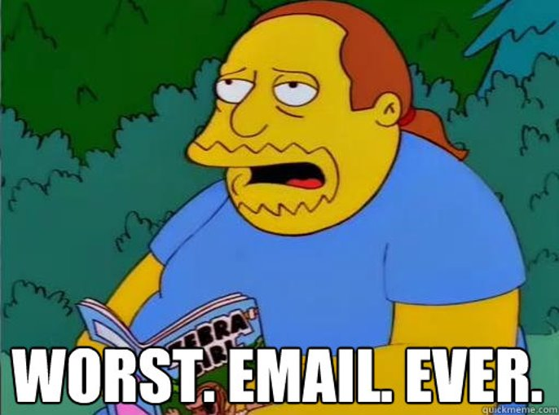
Emails
Notes:
http://dictionary.cambridge.org/dictionary/english/email

Slide 20
How many mistakes can you find?
Emails
From: sexybeast69@gmail.com
To: john@thecompany.be
CC: anne@thecompany.be; silvy@thecompany.be; abdel@thecompany.be; wah@thecompany.be;diego@thecompany.be
BCC: edward@thecompany.be; alphonse@thecompany.be
Subject: URGENT!!!!!!!!
Good afternoon Mr. Jon,
I am writing to you today to introduce myself. I am Michael D. Luffy and I am hear in Antwerp for the next month. I have been in the business for 25 years. Please call me if you have any upcoming promotions. Read the attached document to see what we can offer to you and you’re company.
Toodles, Da Pirate King
20

Slide 21

Emails
Dear Mr. Williams,
It was very nice meeting you at the IT fair. I hope you had a smooth trip back to the UK.
Please find attached a document with information about Novacup. Samantha Lewis is our purchasing manager; I’m copying her in on this. I will also forward your details to Mrs Howard, our CEO.
Please don’t hesitate to contact me if you require any other information.
Best regards, Clark Kent
1 IT6a
Perfect email.
Source: https://strangenotions.com (2025)
21

Slide 22
Emails
Dear Mr. Williams,
It was very nice meeting you at the IT fair. I hope you had a smooth trip back to the UK.
Please find attached a document with information about Novacup. Samantha Lewis is our purchasing manager; I’m copying her in on this. I will also forward your details to Mrs Howard, our CEO.
Please don’t hesitate to contact me if you require any other information.
Best regards, Clark Kent
1 IT6a
Greeting
Dear Mr., Mrs. or Ms. + surname
Dear, Hi, Morning, … ?
NO!
Note: Comma is optional
22

Slide 23
Emails
Dear Mr. Williams,
It was very nice meeting you at the IT fair. I hope you had a smooth trip back to the UK.
Please find attached a document with information about Novacup. Samantha Lewis is our purchasing manager; I’m copying her in on this. I will also forward your details to Mrs Howard, our CEO.
Please don’t hesitate to contact me if you require any other information.
Best regards, Natasha Romanoff
1 IT6a
2. Opening
Say something nice, or say thank you for something (for a previous email for example)
Yes, you want to please here!
23

Slide 24
Emails
Dear Mr. Williams,
It was very nice meeting you at the IT fair. I hope you had a smooth trip back to the UK.
Please find attached a document with information about Novacup. Samantha Lewis is our purchasing manager; I’m copying her in on this. I will also forward your details to Mrs Howard, our CEO.
Please don’t hesitate to contact me if you require any other information.
Best regards, Selina Kyle
1 IT6a
3. Body
This is why you are writing this email. Be concise and to the point. Keep it short.
24

Slide 25
Emails
Dear Mr. Williams,
It was very nice meeting you at the IT fair. I hope you had a smooth trip back to the UK.
Please find attached a document with information about Novacup. Samantha Lewis is our purchasing manager; I’m copying her in on this. I will also forward your details to Mrs Howard, our CEO.
Please don’t hesitate to contact me if you require any other information.
Best regards, Clark Kent
1 IT6a
4. Closing
You say something nice again, or you thank again.
Yes, you want to please again.
25

Slide 26
Emails
Dear Mr Williams,
It was very nice meeting you at the trade fair. I hope you had a smooth trip back to the UK.
Please find attached a document with information about Novacup. Samantha Lewis is our purchasing manager, I’m copying her in on this. I will also forward your details to Mrs Howard, our CEO.
Please don’t hesitate to contact me if you require any other information.
Best regards,
Peter Parker
5. Ending
Best regards
Kind regards
Yours sincerely
+ your name
Note:
Comma at beginning? Comma at the end.
No comma at beginning? No comma at the end!
26

Slide 27
Emails
Dear Mr. Williams,
It was very nice meeting you at the IT fair. I hope you had a smooth trip back to the UK.
Please find attached a document with information about Novacup. Samantha Lewis is our purchasing manager; I’m copying her in on this. I will also forward your details to Mrs Howard, our CEO.
Please don’t hesitate to contact me if you require any other information.
Best regards, Clark Kent
1 IT6a
6. Email vocabulary
Attached, attachment
To copy someone in on an email
To forward
27

Slide 28
Emails
This is a paragraph. A paragraph is a block of text kept together.
This is a new paragraph. You should always leave an empty line in between paragraphs. So, this is WRONG.
7. Paragraphs
Include only one idea in each paragraph
Starting a new line = starting a new paragraph
In emails paragraphs can be short.
28

Slide 29
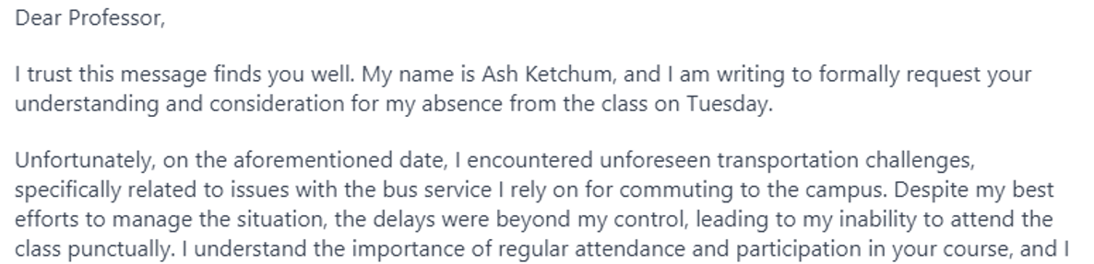
Emails
AI is for
inspiration
spell / grammar checking
NOT writing texts.
29

Slide 30
Emails
Write a formal email to your HR Manager (bruce.wayne@ap.be) about personality tests: you want to convince them to use it or not use it. State your opinion clearly and give 2 arguments pro or con. Also think about your weak points and already counter them within your text. Make sure your CEO (bruce.banner@ap.be) also receives this email (and tell the HR manager that he's also receiving this). Think of ALL the different elements your email should contain. Be concise and to the point. (minimum 400 words)
Previous exam question.

Slide 31
Emails
Write a formal email to your HR Manager (bruce.wayne@ap.be) about brainstorming: you want to convince them to use it or not use it. State your opinion clearly and give 2 arguments pro or con. Also think about your weak points and already counter them within your text. Make sure your CEO (bruce.banner@ap.be) also receives this email (and tell the HR manager that he's also receiving this). Think of ALL the different elements your email should contain. Be concise and to the point. (minimum 400 words)
Previous exam question.

Slide 32
Emails
From: student@student.ap.be To: bruce.wayne@ap.be CC: bruce.banner@ap.be BCC: Subject: Use of brainstorming during team meetings
Dear Mr. Wayne,
I hope this email finds you good. A few days ago we had a conversion in your office about the team's performance. After researching multiple methodes on how to improve our performance, I landed on brainstorming. This can be used on our team, other teams, or even completely different departments.
By including a short brainstorming session in the weekly meetings, we could strongly increase the amount creative ideas produced by our team. Besides that, it would allow everyone to provide their concepts, and be a good way for the team to work together. It is important that we know not each ideas will actually make it into a finished product or system. Some of them may even be completely unusable. Because of this, i also think it is important to limit the amount of time we spend on brainstorming to, for example, 10 minutes per meeting. This can then be followed by a discussion of aroud 5 minutes to see which concepts we want to explore furth.
To make all of this possible, I have found a tool which allow you to brainstorm online. This is important because most of our meetings are either fully online via Teams, or include some people that are joining via Teams. The tool is completely free, open-source, and can be integrated with our systems without too much issues. I have also got this confirmed by IT. According to them, they should be able to integrate it within a week if needed. It would allow everyone to put in their ideas, after which we can go over them to and mark those we want to look in further. As I tend to make my meeting too long, I noticed that this tool also allows you to set a time limit for both the brainstorming itself, and the marking of good concepts. All this information can than be stored on Sharepoint so anyone can look into it later.
Although I' am aware that the latest few weeks my team's performance has been lower than usual, and team meetings have been longer than they should, I really do believe that making use of brainstorming can cause a positive change. Although this will indeed increase our meeting times by around 15 minutes, I have seen some quiet good results from other companies using this method as well. I have copied in Bruce Banner with this email to ensure he knows about this idea as well. If this turns out not to improve our performance over the course of 2-3 months, we can simple remove it from our meetings again and search for alternative solutions.
If you have any quesions regarding this, please feel free to let me know. I would be more than happy to have a meeting about this with u as well if this would provide a better insight. My availability is on the Google Calendar, so you can schedule a meeting with me there. I hope to see u around in the office next week as well so we can discuss this further.
Kind regards,

Slide 33
Emails
From: student@student.ap.be To: bruce.wayne@ap.be CC: bruce.banner@ap.be BCC: Subject: Use of brainstorming during team meetings
Dear Mr. Wayne,
I hope this email finds you good. A few days ago we had a conversion in your office about the team's performance. After researching multiple methodes on how to improve our performance, I landed on brainstorming. This can be used on our team, other teams, or even completely different departments.
By including a short brainstorming session in the weekly meetings, we could strongly increase the amount creative ideas produced by our team. Besides that, it would allow everyone to provide their concepts, and be a good way for the team to work together. It is important that we know not each ideas will actually make it into a finished product or system. Some of them may even be completely unusable. Because of this, i also think it is important to limit the amount of time we spend on brainstorming to, for example, 10 minutes per meeting. This can then be followed by a discussion of aroud 5 minutes to see which concepts we want to explore furth.
To make all of this possible, I have found a tool which allow you to brainstorm online. This is important because most of our meetings are either fully online via Teams, or include some people that are joining via Teams. The tool is completely free, open-source, and can be integrated with our systems without too much issues. I have also got this confirmed by IT. According to them, they should be able to integrate it within a week if needed. It would allow everyone to put in their ideas, after which we can go over them to and mark those we want to look in further. As I tend to make my meeting too long, I noticed that this tool also allows you to set a time limit for both the brainstorming itself, and the marking of good concepts. All this information can than be stored on Sharepoint so anyone can look into it later.
Although I' am aware that the latest few weeks my team's performance has been lower than usual, and team meetings have been longer than they should, I really do believe that making use of brainstorming can cause a positive change. Although this will indeed increase our meeting times by around 15 minutes, I have seen some quiet good results from other companies using this method as well. I have copied in Bruce Banner with this email to ensure he knows about this idea as well. If this turns out not to improve our performance over the course of 2-3 months, we can simple remove it from our meetings again and search for alternative solutions.
If you have any quesions regarding this, please feel free to let me know. I would be more than happy to have a meeting about this with u as well if this would provide a better insight. My availability is on the Google Calendar, so you can schedule a meeting with me there. I hope to see u around in the office next week as well so we can discuss this further.
Kind regards, →0/15 for language

Slide 34
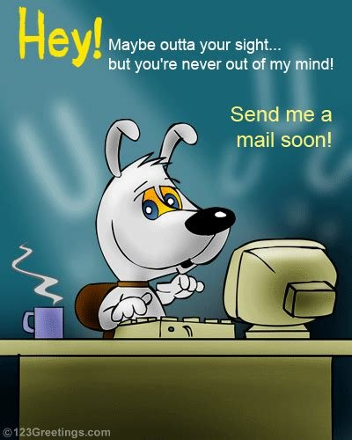
Emails
Contact a friend.
Source: https://www.123greetings.com/stay_in_touch/keep_in_touch/staykeep37.html (2025)
Send an email of 150 words to a fellow student about your favourite course(s). Explain what it is, why you love it and what you will use it for later.
The other person gives feedback orally after reading the email.
34

Slide 35
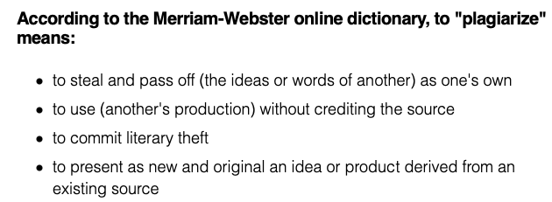
Sources
Dictionary definition.
Source: https://www.plagiarism.org/article/what-is-plagiarism (12025)
Plagiarism on AP = 0 and fraud commission
Notes:
32

Slide 36
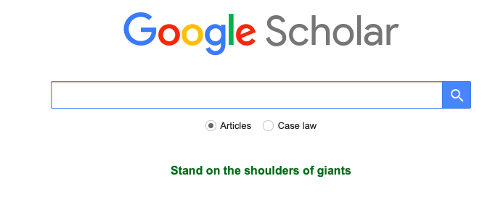
Sources
Helpful sites:
https://www.scribbr.com/citation/generator/apa/
http://www.citethisforme.com
https://www.citationmachine.net
https://scholar.google.com
Use the resources.
Source: https://scholar.google.com(2025)
Notes:
33

Slide 37
Sources
Text
It's easy to create an APA notation (Citation Machine, n.d.) but can an AI do it itself? The answer is yes (OpenAI, 2023).
Sources
OpenAI. (2023). ChatGPT (Mar 14 version) [Large language model]. https://chat.openai.com/chat
Citation Machine® - write smarter. (n.d.). Retrieved March 16, 2021, from https://www.citationmachine.net/
Notes:
34

Slide 38
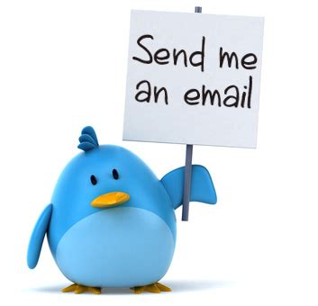
Emails
Send email!
Source: https://iam-chrisjim.github.io (2025)
Optional exercise:
Send me an email about your experiences in the first semester and get feedback.
(deadline May 8 - 23h59)
38

Slide 39
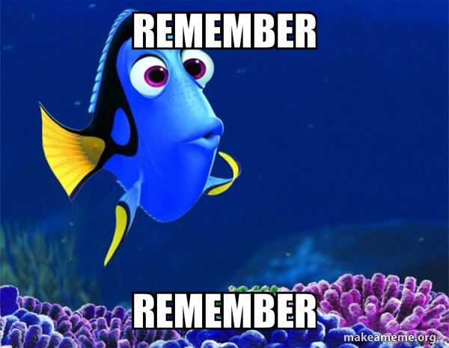
What do you need to remember?
Writing texts and emails.
On written exam no grammarly / spellcheck.
Alinea if it is one of your facilities.
Points on content and grammar/spelling/punctuation....
Remember .
Source: https://makeameme.org/meme/remember-remember-ed08870dab (2025)

Slide 40
Questions?

